Slide 1
暑期学习成果汇报
汇报人：朱奕晟

Slide 2
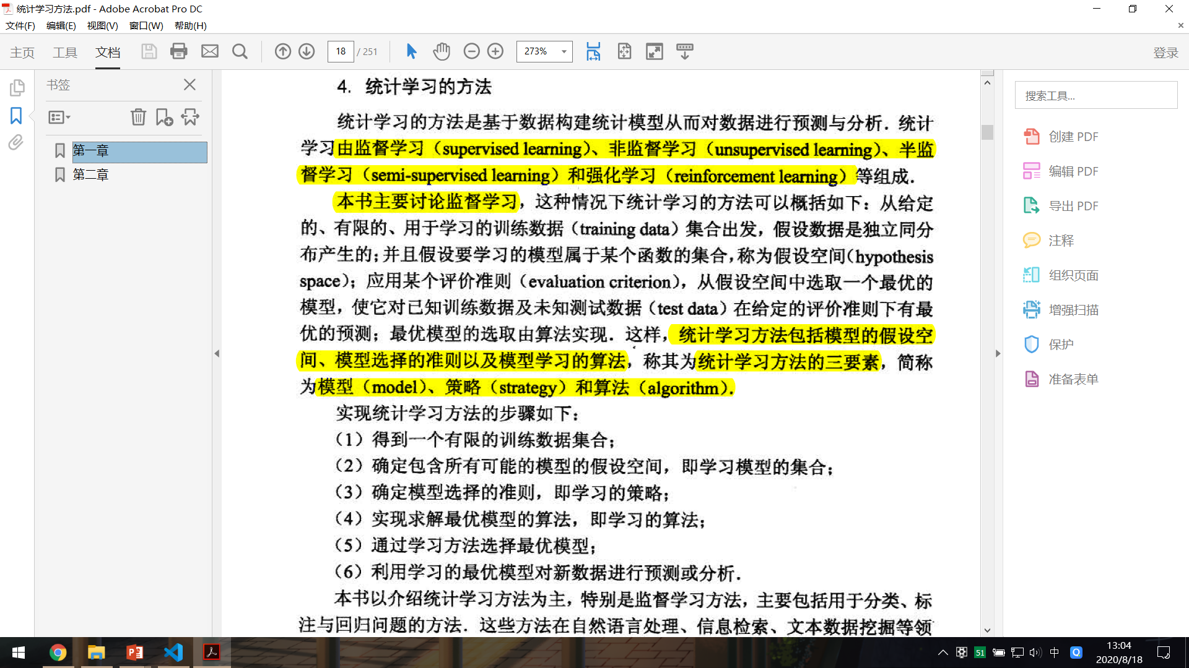
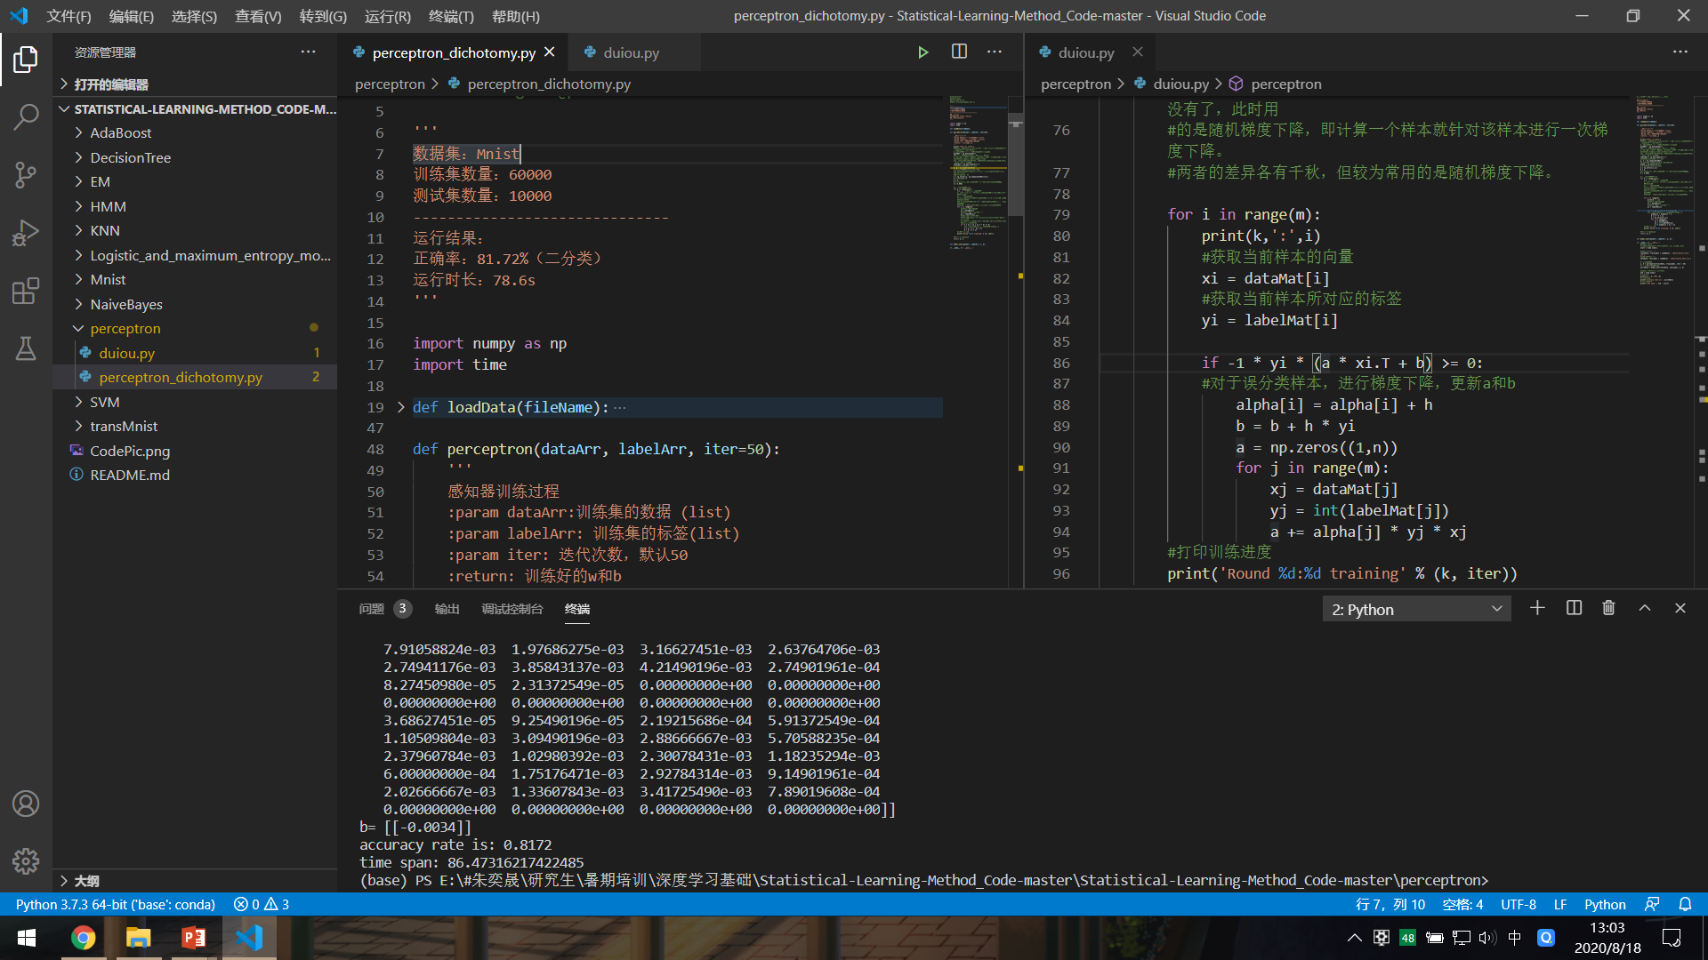
学习汇报
近期对李航的《统计学习方法》（第一版）中的第一章和第二章进行学习和研究，并对其中的知识点和公式进行推导和编程验证，现将学习成果进行汇报

Slide 3
目录
1
2
3
4
第一章重点知识总结
第一章疑难问题汇总
第二章重点知识总结
第二章疑难问题汇总

Slide 4
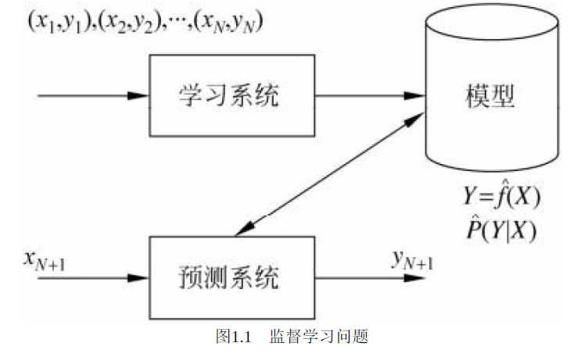
1
1
第一章重点知识总结
统计学习方法概论
统计学习的方法是基于数据构建统计模型从而对数据进行预测与分析统计学习由 、非监督学习、半监督学习和强化学习等组成.
监督学习
监督学习：利用训练数据集学习一个模型，再用模型对测试样本集进行预测
Part one

Slide 5
1
第一章重点知识总结
统计学习方法概论
监督学习的实现步骤：
1.得到一个有限的训练数据集合
2.确定模型的假设空间，也就是所有的备选模型
3.确定模型选择的准则，即学习的策略
4.实现求解最优模型的算法
5.通过学习方法选择最优模型
6.利用学习的最优模型对新数据进行预测或分析
Part one

Slide 6

1
第一章重点知识总结
统计学习方法概论
训练集：
$$T=\left\{\left(x_{1},y_{1}\right),\left(x_{2},y_{2}\right),⋯,\left(x_{N},y_{N}\right)\right\}$$
实例$x$的特征向量:
$$x={\left(x^{\left(1\right)},x^{\left(2\right)},⋯,x^{\left(n\right)}\right)}^{T}$$
模型：
1）决策函数 $Y=f\left(X\right)$
预测形式 $y=f\left(x\right)$
2）条件概率分布 $P\left(\left.Y\right|X\right)$
预测形式 $\arg{\max_{y}P\left(\left.y\right|x\right)}$
Part one

Slide 7
1
第一章重点知识总结
统计学习方法概论
模型
统计学习
三要素
策略
算法
Part one

Slide 8

1
第一章重点知识总结
统计学习方法概论
模型(假设空间）：
决策函数
$$F=\left\{\left.f\right|Y=f_{θ}\left(X\right),θ∈R^{n}\right\}$$
条件概率分布
$$F=\left\{\left.P\right|P_{θ}\left(\left.Y\right|X\right),θ∈R^{n}\right\}$$
Part one

Slide 9

1
第一章重点知识总结
统计学习方法概论
策略：
损失函数
0-1:$L\left(Y,f\left(X\right)\right)=\left\{\begin{matrix}1,Y≠f\left(X\right) \\ 0,Y=f\left(X\right)\end{matrix}\right.$
$$平方：L\left(Y,f\left(X\right)\right)={\left(Y−f\left(X\right)\right)}^{2}$$
$$绝对：L\left(Y,f\left(X\right)\right)=\left|Y−f\left(X\right)\right|$$
$$对数：L\left(Y,P\left(\left.Y\right|X\right)\right) =\log{P\left(\left.Y\right|X\right)}$$
Part one

Slide 10

1
第一章重点知识总结
统计学习方法概论
策略：
经验风险最小化：
$$\min_{f∈F}\frac{1}{N}\sum_{i=1}^{N}{L\left(y_{i},f\left(x_{i}\right)\right)}$$
结构风险最小化
$$\min_{f∈F}\frac{1}{N}\sum_{i=1}^{N}{L\left(y_{i},f\left(x_{i}\right)\right)}+λJ\left(f\right)$$
Part one

Slide 11

1
第一章重点知识总结
统计学习方法概论
训练$误差$
$$\frac{1}{N}\sum_{i=1}^{N}{L\left(y_{i},\hat{f}\left(x_{i}\right)\right)}$$
测试误差
$$\frac{1}{N^{′}}\sum_{i=1}^{N^{′}}{L\left(y_{i},\hat{f}\left(x_{i}\right)\right)}$$
过拟合问题
Part one

Slide 12
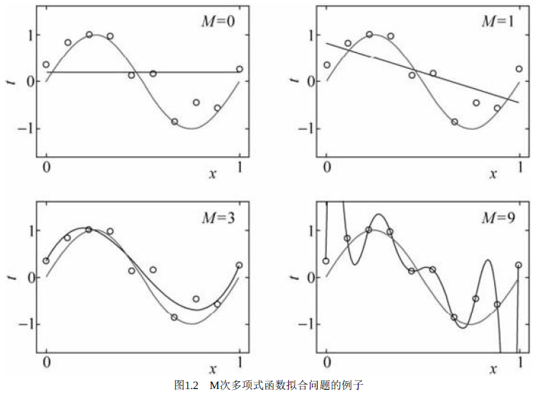
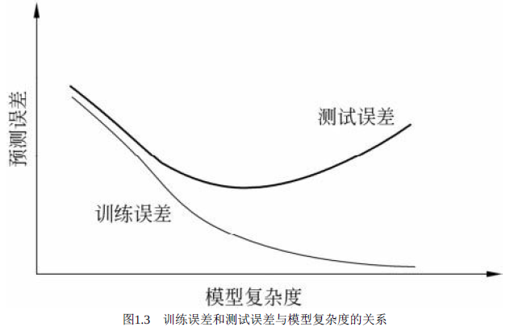


1
第一章重点知识总结
统计学习方法概论
多项式$拟合$问题
最小化$结构风险$
$$\frac{1}{N}\sum_{i=1}^{N}{L\left(y_{i},f\left(x_{i}\right)\right)}+λJ\left(f\right)$$
交叉验证
Part one

Slide 13
2
Part two
1
第一章重点知识总结
第一章疑难问题汇总
2
第一章疑难问题汇总
泛化能力
生成模型与判别模型
3
第二章重点知识总结
4
第二章疑难问题汇总

Slide 14


2
第一章疑难问题汇总
统计学习方法概论
定理1.1泛化误差上界
对于二分类问题，当假设空间是有限个函数的集合$F=\left\{f_{1},f_{2},⋯,f_{d}\right\}$时，对任意一个函数$f∈F$，至少以概率$1−δ$，以下不等式成立：
$$R\left(f\right)≤\hat{R}\left(f\right)+ε\left(d,N,δ\right)$$
其中
$$ε\left(d,N,δ\right)=\sqrt{\frac{1}{2N}\left(\log{d}+\log{\frac{1}{δ}}\right)}$$
生成方法
$$P\left(\left.Y\right|X\right)=\frac{P\left(X,Y\right)}{P\left(X\right)}$$
判别方法
$$f\left(X\right)或P\left(\left.Y\right|X\right)$$
Part two

Slide 15
3
THREE
3
ONE
TWO
FOUR
1
2
4
第一章重点知识总结
第一章疑难问题汇总
第二章疑难问题汇总
第二章重点知识总结
Part three

Slide 16



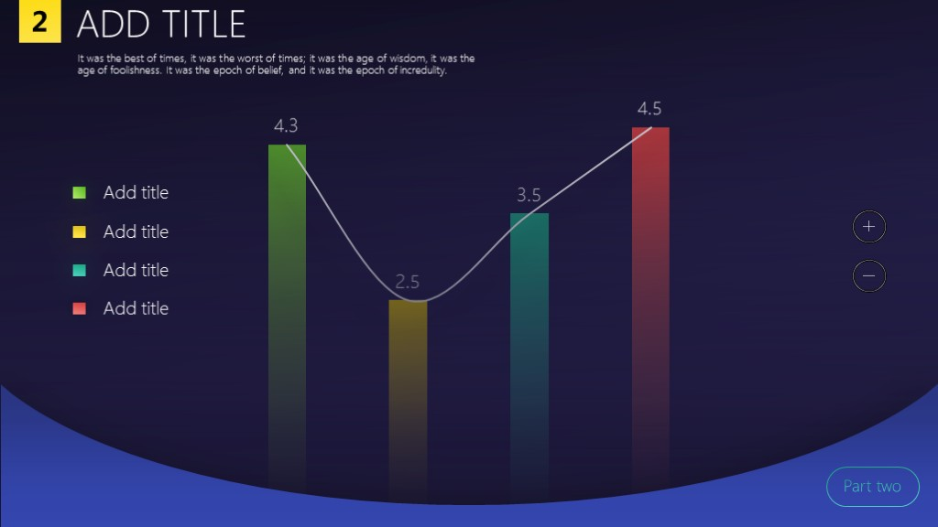
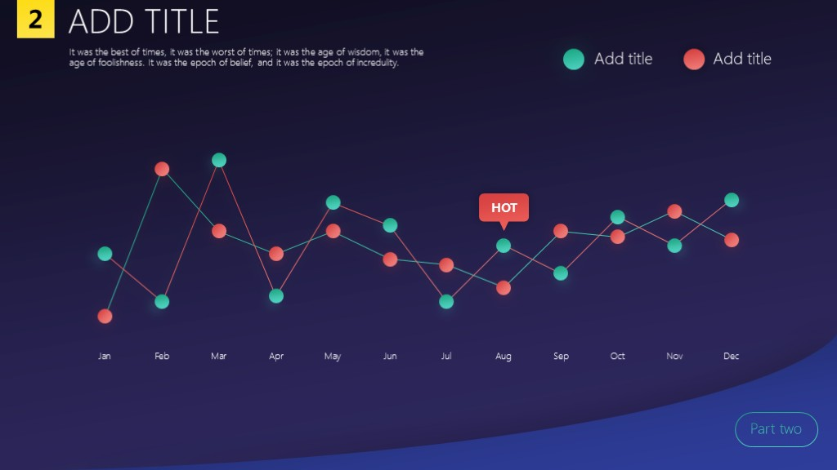
ADD TITLE HERE
It was the best of times, it was the worst of times; it was the age of wisdom, it was the age of foolishness. It was the epoch of belief, and it was the epoch of incredulity. It was the season of light, and it was the season of darkness.

Slide 17
3
ADD TITLE HERE
O
It was the best of times, it was the worst of times; it was the age of wisdom, it was the age of foolishness. It was the epoch of belief, and it was the epoch of incredulity.
C
It was the best of times, it was the worst of times; it was the age of wisdom, it was the age of foolishness.
It was the best of times, it was the worst of times; it was the age of wisdom
Part three

Slide 18





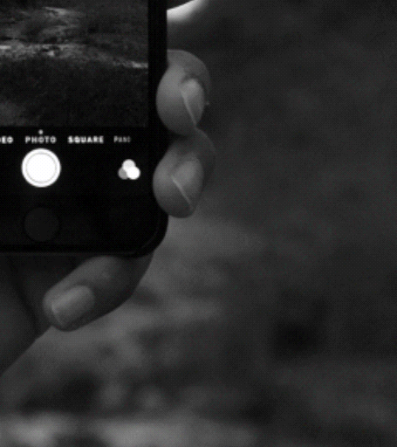
3
ADD TITLE
It was the best of times, it was the worst of times; it was the age of wisdom, it was the age of foolishness. It was the epoch of belief, and it was the epoch of incredulity.
Part three

Slide 19
3
ADD TITLE
It was the best of times, it was the worst of times; it was the age of wisdom, it was the age of foolishness. It was the epoch of belief, and it was the epoch of incredulity.
ADD TITLE
ADD TITLE
ADD TITLE
It was the best of times
it was the worst of times
It was the best of times
it was the worst of times
It was the best of times
it was the worst of times
ADD TITLE
ADD TITLE
It was the best of times
it was the worst of times
It was the best of times
it was the worst of times
ADD TITLE
It was the best of times
it was the worst of times
Part three

Slide 20
4
ADD TITLE
It was the best of times, it was the worst of times; it was the age of wisdom, it was the age of foolishness. It was the epoch of belief, and it was the epoch of incredulity.
TWO
THREE
It was the best of times, it was the worst of times
it was the age of wisdom
It was the best of times, it was the worst of times
it was the age of wisdom
2
3
FOUR
ONE
4
It was the best of times, it was the worst of times
it was the age of wisdom
It was the best of times, it was the worst of times
it was the age of wisdom
1
ADD TITLE HERE
ADD TITLE HERE
ADD TITLE HERE
ADD TITLE HERE
Part four

Slide 21


4
ADD TITLE
It was the best of times, it was the worst of times; it was the age of wisdom, it was the age of foolishness. It was the epoch of belief, and it was the epoch of incredulity.
Part four

Slide 22
4
ADD TITLE
It was the best of times, it was the worst of times; it was the age of wisdom, it was the age of foolishness. It was the epoch of belief, and it was the epoch of incredulity.
O
ADD TITLE HERE
C
It was the best of times, it was the worst of times; it was the age of wisdom, it was the age of foolishness. It was the epoch of belief, and it was the epoch of incredulity.
25%
It was the best of times, it was the worst of times; it was the age of wisdom, it was the age of foolishness.
ADD TITLE
Part four

Slide 23


4
It was the best of times, it was the worst of times; it was the age of wisdom, it was the age of foolishness. It was the epoch of belief.

Slide 24

4
ADD TITLE HERE
It was the best of times, it was the worst of times; it was the age of wisdom, it was the age of foolishness. It was the epoch of belief, and it was the epoch of incredulity.
It was the best of times, it was the worst of times; it was the age of wisdom, it was the age of foolishness.
write in content

Slide 25
Thanks
It was the best of times it was the worst of times it was the age of wisdom
it was the age of foolishness

Slide 26

设计规范

Slide 27

5
设计规范
渐变样式使用方法
1
3
2
格式刷
先选中样式
选择目标对象
其他颜色相同
Part five

Slide 28
5
设计规范
如何分割图片
STEP ONE
插入表格
Part five

Slide 29
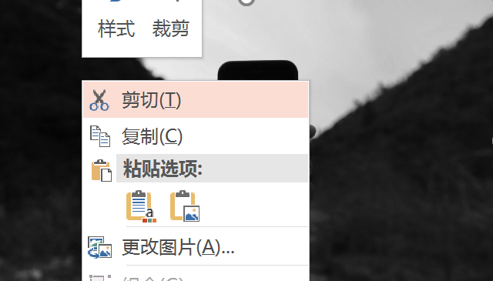
5
设计规范
如何分割图片
STEP TWO
剪切图片
Part five

Slide 30

5
设计规范
如何分割图片
STEP THREE
填充表格
右键表格 选择形状格式 图片填充
Part five

Slide 31
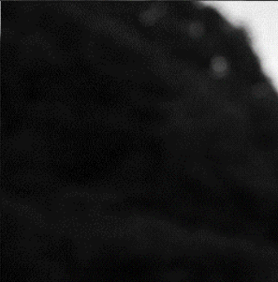


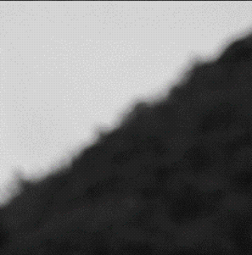




5
设计规范
如何分割图片
STEP FOUR
取消组合
先ctrl+x剪切图片 然后ctrl+alt+v
选择增强型图元文件 两次取消组合
Part five

Slide 32

5
任何问题
关注公众号留言
the last

